Slide 1
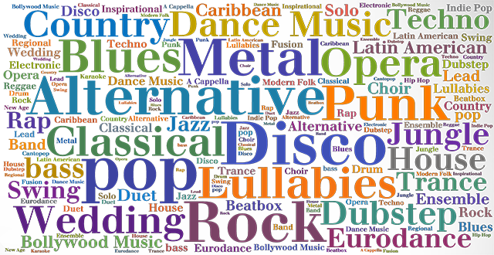
Music Genre Classification
Robert Adragna
Bill Sun

Slide 2

Goal and Motivation
Correctly Predict the genre of any piece of Western music.
Auto-tag playlists, DJ events.
Ill-defined problem = good for Machine Learning
Notes:
We imagine a future where everyone has the power to understand and know their music, and can use it to brighten somebody’s day - whether designing the perfect running playlist or throwing the perfect party

Slide 3

Data
Used Spotify API to collect raw audio data in mp3 format
10-second long audio clips
4000 songs from 4 genres
Hip-hop (rap)
Rock
Classical
Jazz
Notes:
We crawled the spotify API, which has 30s preview of many different songs available
Cut the 30s songs into samples of 4.54 seconds each in order to reduce computation
Constructed a balanced dataset of 1000 songs from 4 different genres

Slide 4

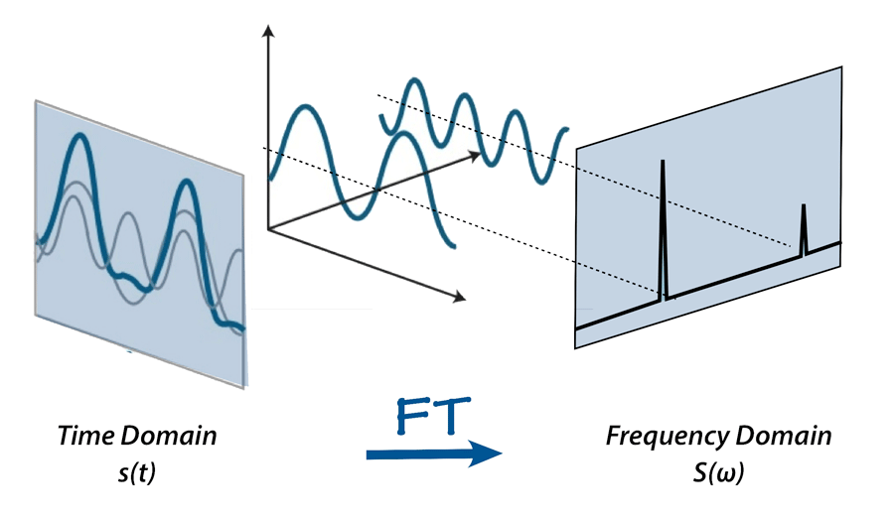
Initial Experiments
We first tried training on raw audio using a 1D CNN
Then tried training on Fourier transformed audio using a 2D CNN
Both models did not achieve satisfactory results - almost random
We looked for better solutions

Slide 5
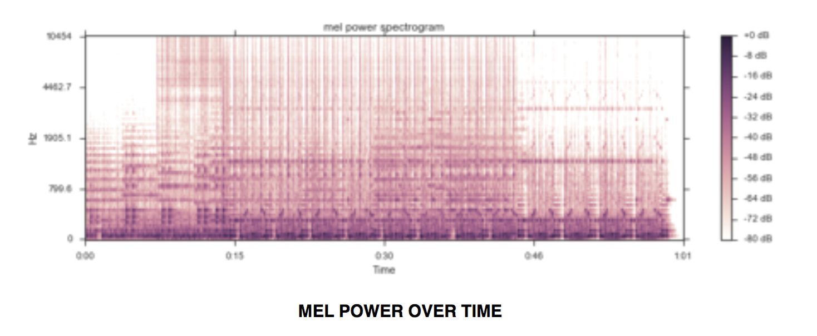
Further Pre-processing
MFCC: Mel-frequency cepstral coefficients
A measure of short-term audio power
We took a time series of MFCC coefficients for every segment of 0.1 seconds in the audio
Stack into matrix

Slide 6

Software Structure Pt.1 - Preprocess & Train
download_songs()
save_best_model()
convert_2_numpy()
train()
evaluate()
normalize_data()
convert_2_mfcc()
Notes:
The Data starts on the web

Slide 7

Software Structure Pt.2 - Testing
input_mp3()
evaluate_test()
cut_sample()
best model
convert_2_numpy()
convert_2_mfcc()

Slide 8
Model Structure
Softmax
Jazz
Rap
Rock
Classical
FC layers
A multi-layer gated recurrent unit (GRU) RNN followed by fully-connected linear layers
Architecture and Hyper-parameters:
Batch size = 10
Learning rate = 0.001
Num epochs = 10
Hidden dim = 100
Embedding dim = 52
1 FC layer: size = 100
Output genres = 4
Time series of MFCC coefficients

Slide 9
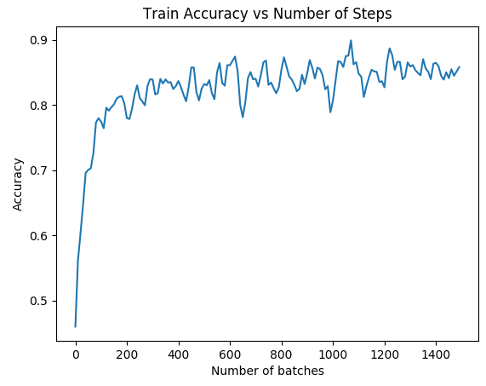
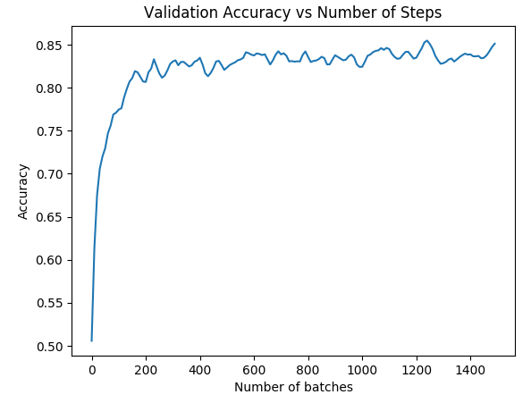
Training Results

Slide 10
Test Results and Comparisons
Test set: 640 songs, 160 songs per genre. 72.3% accuracy
Genre | Classical | Jazz | Rap | Rock | Recall
Classical | 107 | 49 | 3 | 1 | 66.9%
Jazz | 33 | 78 | 10 | 39 | 48.8%
Rap | 0 | 4 | 150 | 6 | 93.8%
Rock | 2 | 7 | 23 | 128 | 80.0%
Precision | 75.4% | 56.7% | 80.6% | 73.5%
Academic standard for 4 genre classification: [1]
63.75%
[1] https://courses.engr.illinois.edu/ece544na/fa2014/Tao_Feng.pdf

Slide 11

Reflections and Takeaways
Data is King (quantity and quality)
ML = trial-and-error + intuition
Sometimes smaller is better
Notes:
Data is king -
Should have acquired much larger data sources before trying to do learning

Slide 12
Demo Time!

